Slide 1
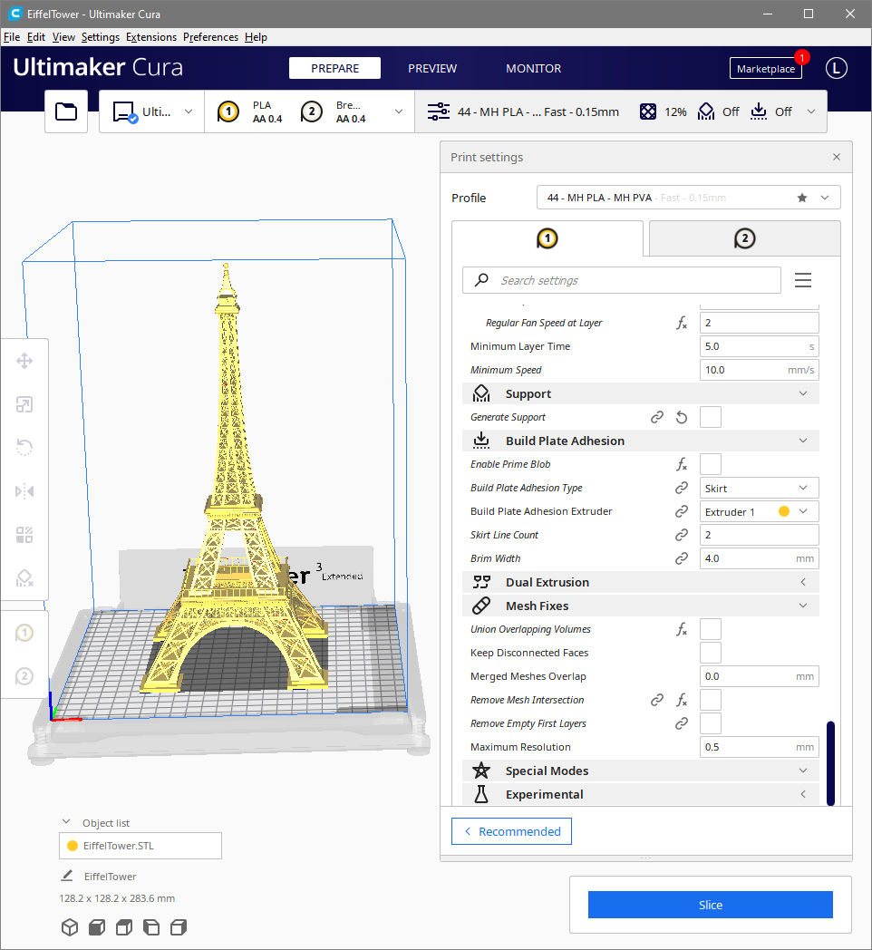
Ultimaker Cura
Profile and User Interface Improvements
Presented by
Lance A. Endres, Ph.D.

Slide 2
Please feel free to interrupt, ask questions, or have me repeat something that is unclear.
Ultimaker Cura Profile Discussion
Notes:
To To bring user-friendly desktop pickTo bring user-friendly desktop pick-and-place technology to the maker community.-and-place technology to the maker community.brTo bring user-friendly desktop pick-and-place technology to the maker community.inTo bring user-friendly desktop pick-and-place technology to the maker community.g user-friendly desktop pick-and-place technology to the maker community.To bring user-friendly desktop pick-and-place technology to the maker community.

Slide 3
Notes:
I’m not trying to claim I have all the answers. My point is, I’m not some internet yahoo popping off about something he has no understanding of. I have a background doing exactly these types of things and I have put significant thought into how I would write the software to solve these problems.

Slide 4
Notes:
I’m not trying to claim I have all the answers. My point is, I’m not some internet yahoo popping off about something he has no understanding of. I have a background doing exactly these types of things and I have put significant thought into how I would write the software to solve these problems.

Slide 5
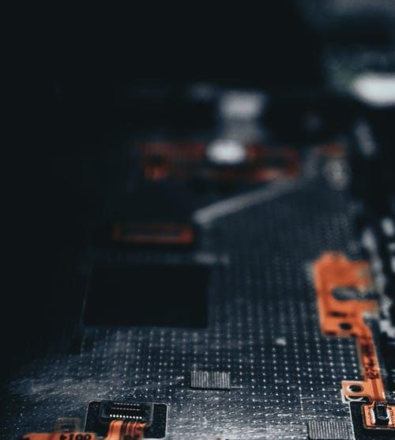
Background
Modern electronics are composed of printed circuit boards and surface mount components.
Notes:
The problem we are trying to solve.

Slide 6
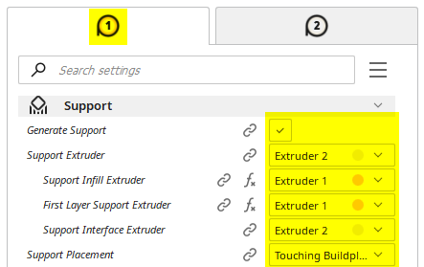
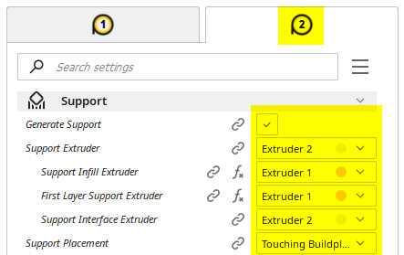
Problems
Duplication of controls on User Interface
2 controls for 1 setting is red flag there is a design issue
Users find it confusing that settings are linked
Non-standard/unique approaches are best avoided

Slide 10
Profile Demonstration Software
A basic example to demonstrate concepts.
A minimum number of settings are incorporated.
Data validation is not complete.
Not intended as “the” solution.
There are many possible valid implementations.
Please focus only on the concepts and learnings.
Take away the Big Picture.

Slide 11
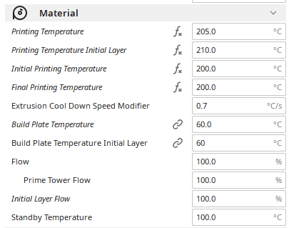
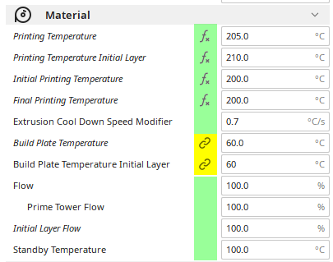
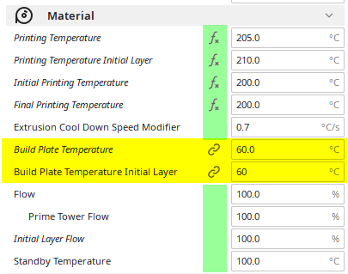
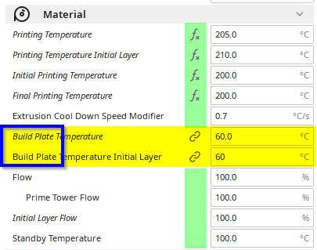
Some Settings Need Moving
Some settings are categorized incorrectly.
They are typically easy to identify.
Categorizing them correctly is typically easy, as well.

Slide 12
The Problem
Small batches of printed circuit boards (PCBs) cannot be assembled either efficiently or cost effectively.
Notes:
The problem we are trying to solve.

Slide 13

Mission statement
To bring user-friendly desktop pick-and-place technology to the maker community.
Notes:
To To bring user-friendly desktop pickTo bring user-friendly desktop pick-and-place technology to the maker community.-and-place technology to the maker community.brTo bring user-friendly desktop pick-and-place technology to the maker community.inTo bring user-friendly desktop pick-and-place technology to the maker community.g user-friendly desktop pick-and-place technology to the maker community.To bring user-friendly desktop pick-and-place technology to the maker community.

